Slide 1
BLINKIT SALES ANALYSIS
BY
TUSHAR KSHIRSAGAR
M.Sc.(Statistics)

Slide 2
SALES BY FAT CONTENT
Low fat products are the primary revenue drivers, contributing 65% to total sales.
Regular products account for 35%, presenting an opportunity to tap into the growing demand for health-focused options.

Slide 3
SALES BY OUTLET LOCATION
(Across Fat Content)
Sales by Fat Content: Low-fat products maintain a strong sales lead over regular products across all outlet tiers, reflecting consumer preference for health-conscious options.
Top-Performing Tiers: Tier 1 outlets lead in sales, followed by Tier 2 and Tier 3 outlets.
Consumer Preference: The trend toward low-fat product sales dominance is consistent, highlighting growing health awareness among customers.

Slide 4
SALES BY ITEM TYPE
Top Performers: Fruits, vegetables, and snacks drive significant revenue, highlighting their strategic importance.
Low Performers: Seafood and breakfast require targeted promotions or diversification to boost sales.
Growth Opportunities: Dairy and frozen foods show potential for inventory optimization and marketing enhancements.

Slide 5
SALES BY OUTLET ESTABLISHMENT
Sales Trends by Outlet Establishment Year:
Initial growth observed from Rs. 78.1K in 2011 to higher values in subsequent years.
Stable sales from 2012-2017, reflecting steady market conditions.
Peak sales in 2018 at Rs. 204.5K, possibly due to promotions or high demand.
Decline post-2018, stabilizing by 2020, indicating market challenges or saturation.

Slide 6
SALES BY OUTLET SIZE
Sales by Outlet Size:
Medium: ₹507.9K (42%) - Leading contributor.
Small: ₹444.8K (37%) - Close second.
Large: ₹249.0K (21%) - Smallest share.
This highlights a strong reliance on medium-sized sales, with smaller contributions from the large and small outlets.

Slide 7
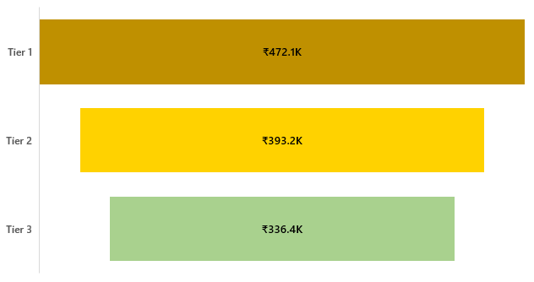
SALES BY OUTLET LOCATION
Sales by Outlet Location:
Tier 1 outlets lead with ₹472.1K, followed by Tier 2 (₹393.2K) and Tier 3 (₹336.4K).
Sales decrease from tier 1 to tier 3, emphasizing the need to optimize Tier 1 strategies while improving lower performance tiers.

Slide 8
SALES BY OUTLET TYPE
Total Sales
Avg Sales
No of Items
Total Sales: Supermarket Type 1 leads with ₹788K, while Supermarket Types 2 & 3 record lower sales at ₹131K each.
Average Sales: Supermarket Type 2 has the highest average at ₹142, followed closely by Supermarket Type 3 and Grocery Stores at ₹140.
Items Sold: Supermarket Type 1 dominates with 5,577 items, while Supermarket Type 2 has the lowest at 928 items.

Slide 9
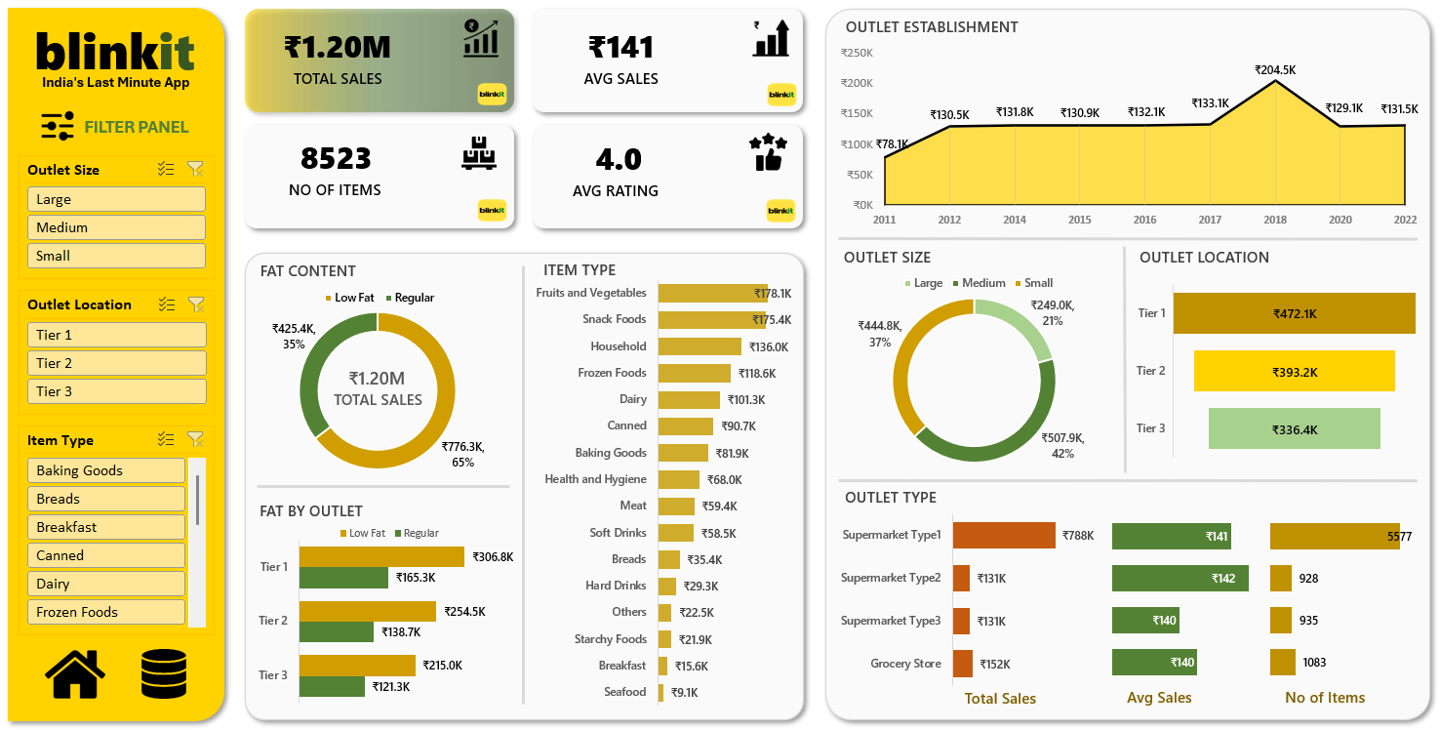

Slide 10
THANK YOU!

